Slide 1
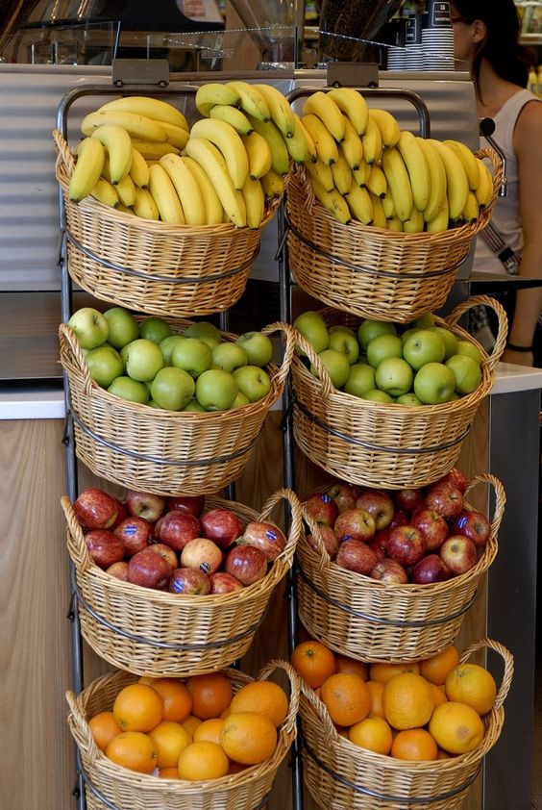
Instacart Market Basket Analysis
Ana Sofia Silva, number: 20200220
José Francisco Alves, number: 20200653
Miguel Nunes, number: 20200615
Mohammadali Gharghi, number: 20200997

Slide 2
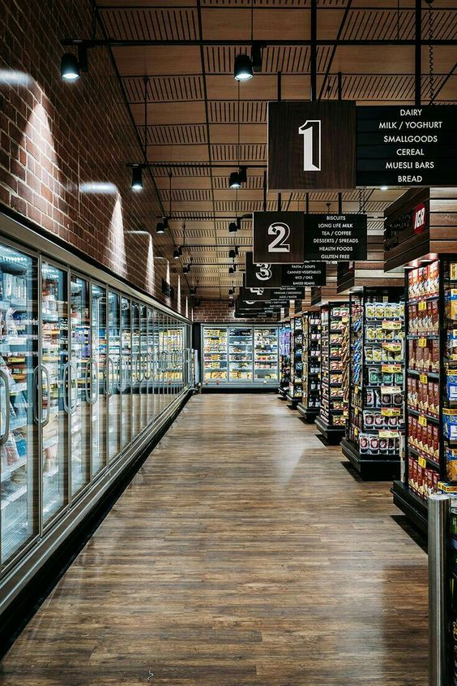
Presentation Structure
Business Goals
Improve the manage of the shopping while speaking with the personal shopper assigned
Optimize the store’s layout, develop cross-promotional programs and develop different marketing strategies for its customers
Answering the topics
What are the main types of consumer behavior in the business?
Which types of products should have an extended amount of product offerings?
Which types of products can be seen as substitutes?
Which items are complementary?
Data Mining Goals
Customer’s data behaviour analysis
Customer segmentation with K-Means
Market Basket Analysis (MBA)

Slide 3
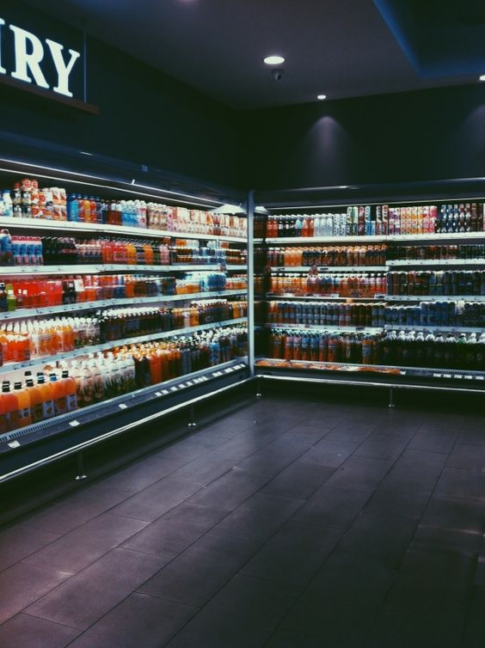

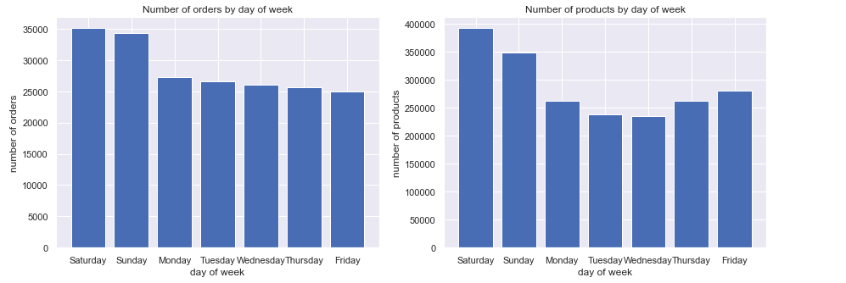
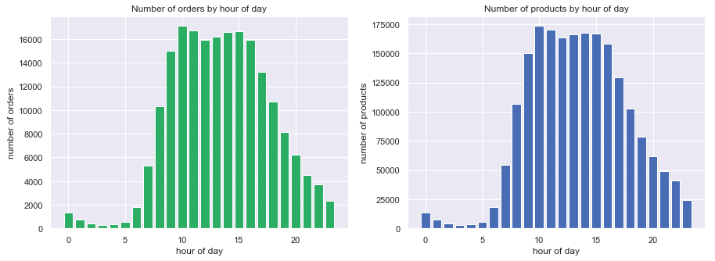
Customer’s Behaviour
The majority of orders and products were hold in the weekend, with a higher incidence in the Weekend and between 10-15 o’clock.

Slide 4
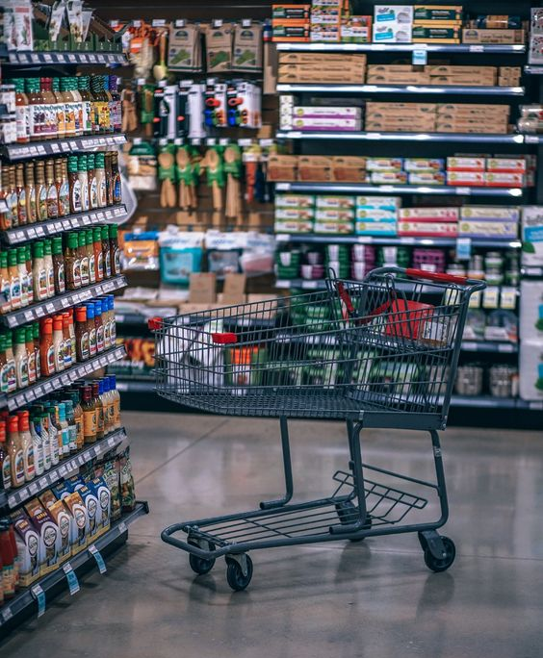
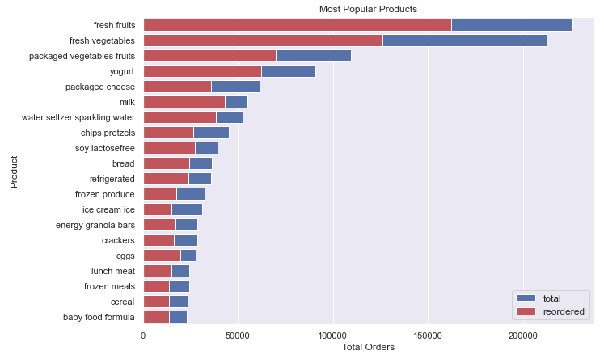
Customer’s Behaviour
The majority of the reorders are made during the daytime with peaks at the 7th and 30th day of the month.
The most popular products are basic needs in food, such as fruits, vegetables, yogurt and milk.

Slide 5

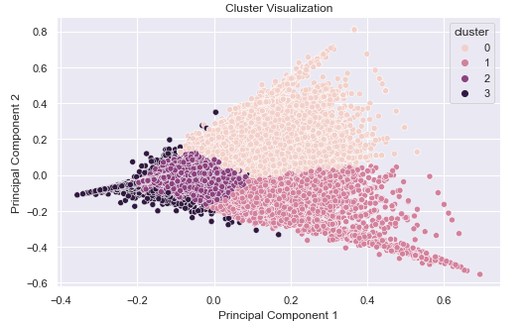
Customer segmentation
Cluster’s Groups
Clustering with K-Means
24,940 customers
1st Group
Fresh
vegetables
15,323 customers
2nd Group
Fresh fruits
62,389 customers
3rd Group
First necessity products
2,621 customers
4th Group
Seltzer Sparkling water

Slide 6

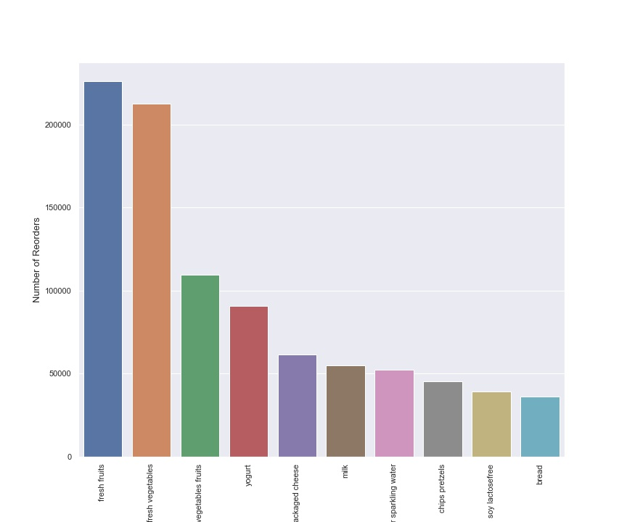
Best-Selling Products
Best product’s sales according to Reorders
Key Factors:
Relatioship between the reorders and the orders, in which these products are ordered again by the same customer after first purchase.
The quantity of items purchased for each purchase that is made.
Sells by departments of the store

Slide 7
Substitute’s Products
Lift <=1:
Antecedent Product | Consequent Product | Lift | Confidence
Sparkling Water | Fresh Vegetables | 0.971915 | 0.431880
Fresh Vegetables | Sparkling Water | 0.971915 | 0.187584
Lift >1:
Antecedent Product | Consequent Product | Lift | Confidence
Fresh Fruits and Fresh Vegetables | Sparkling Water | 1.031723 | 0.199128
Sparkling Water | Fresh Fruits and Fresh Vegetables | 1.031723 | 0.327634
Fresh Fruits | Sparkling Water | 1.034807 | 0.199723
Sparkling Water | Fresh Fruits | 1.034807 | 0.575348

Slide 8
Complementary Products
Confidence>= 0.8 and Lift >= 1.8:
Antecedent Product | Consequent Product | Lift | Confidence
Fresh Fruits and Fresh Herbs | Fresh Vegetables | 1.983463 | 0.881372
Fresh Herbs | Fresh Vegetables | 1.903203 | 0.845707

